Slide 1
ZILLOW GROUP & SMARKETING ATTRIBUTION
Seattle University Capstone: Boardroom Analytics
Zillow Decision Science

Slide 2
Role, focus, title
Tenure at Zillow Group
Path to Zillow Group
Home town
4th of July plans
Get to know us

Slide 3
TODAY’S AGENDA
What is Zillow? And why does it exist?
Marketing’s role
We’ve got problems
You get to solve them
Notes:
Who has used Zillow.com before?
-What for?
What other sites do you use?

Slide 4














CONSUMER BRANDS
BUSINESS BRANDS
Notes:
Zillow Group is a portfolio of brands that encompass “all things home.” Our consumer brands give people information about mortgages, homes for sale and rent, information for homebuyers, and home design inspiration. Two of our consumer brands – StreetEasy and Naked Apartments – focus on the complex New York City real estate market.
We’re a media company, and we work closely with real estate agents who purchase advertising on our consumer sites.
Our portfolio also includes business-to-business brands that make real estate transactions easier for agents and home shoppers.

Slide 5
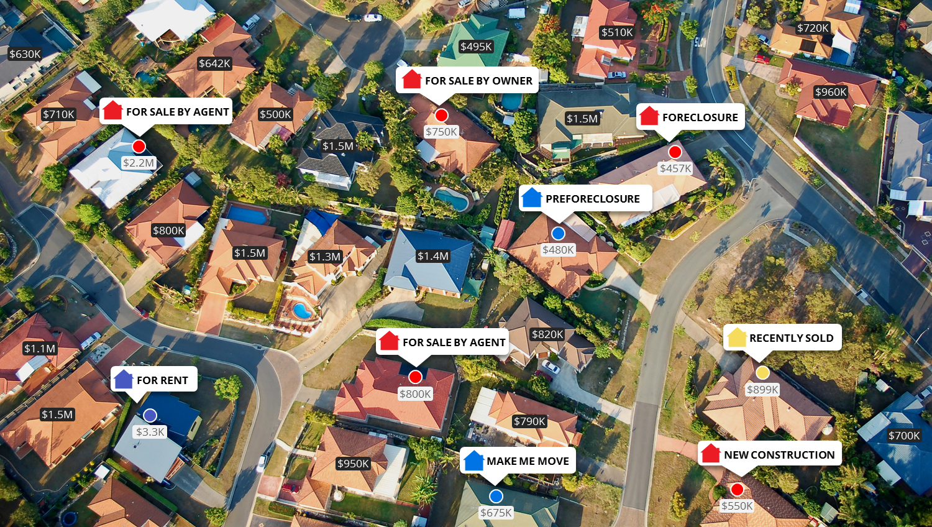
We turned on the lights.

Slide 6
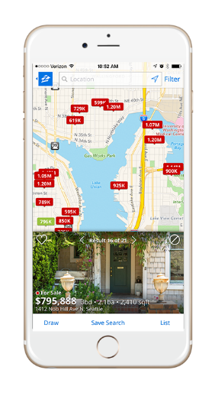


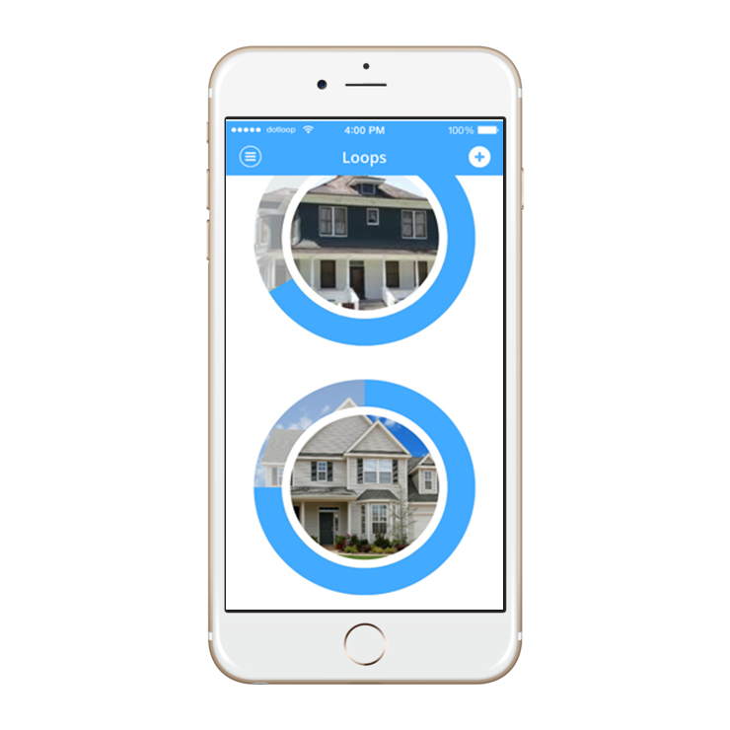
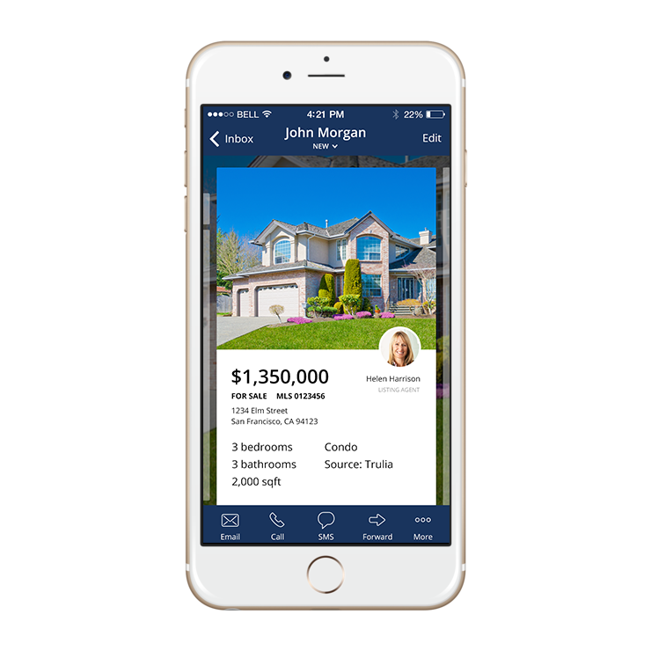


Our formula
attract audience
great people
great products
connect via tools
engage professionals
Notes:
Here’s our formula for how we’re a successful company: we hire great people, we build great products that attract a massive audience, we then engage the professionals who want to connect with that audience, and we help them interact through great tools. I’ll go into each of these areas a bit further.
DO THE HANDSHAKE THING

Slide 7


Zillow makes handshakes happen
Consumer
Real Estate Professional

Slide 8
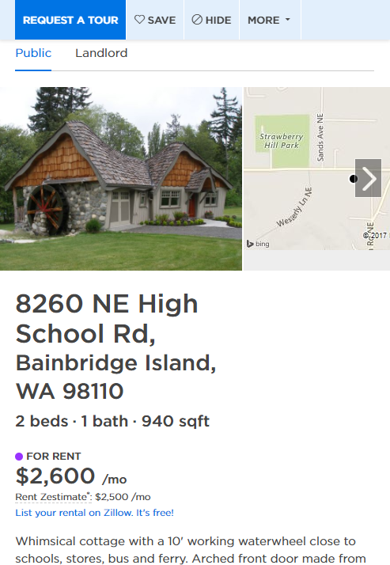
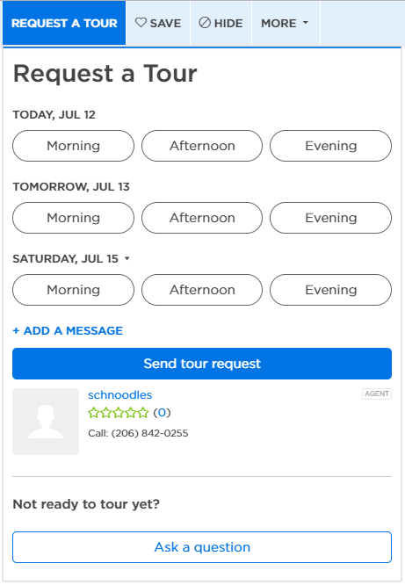
Rental Shopper
Property Manager

Slide 9
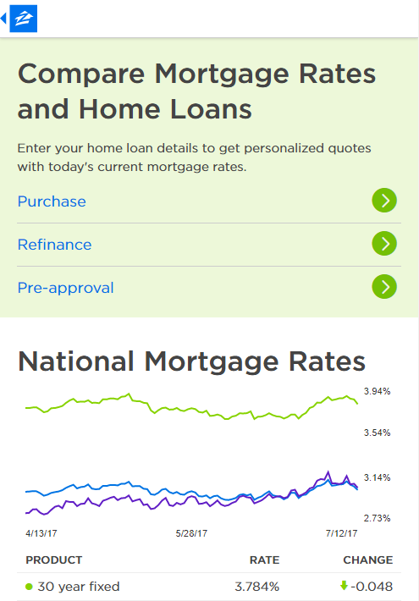
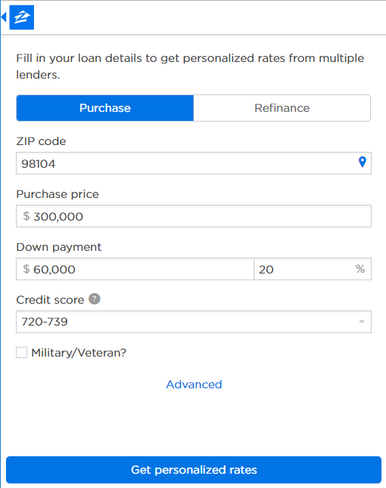
Mortgage Shopper
Financial Institution

Slide 10
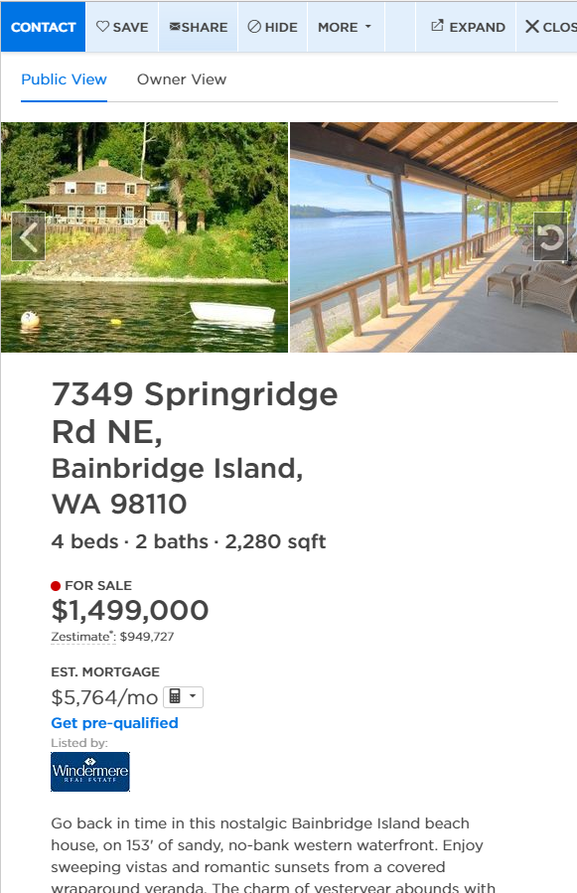
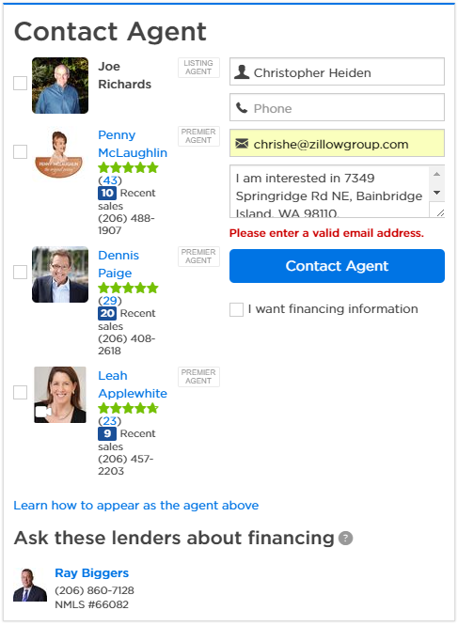
Home Shopper
Real Estate Agent

Slide 11
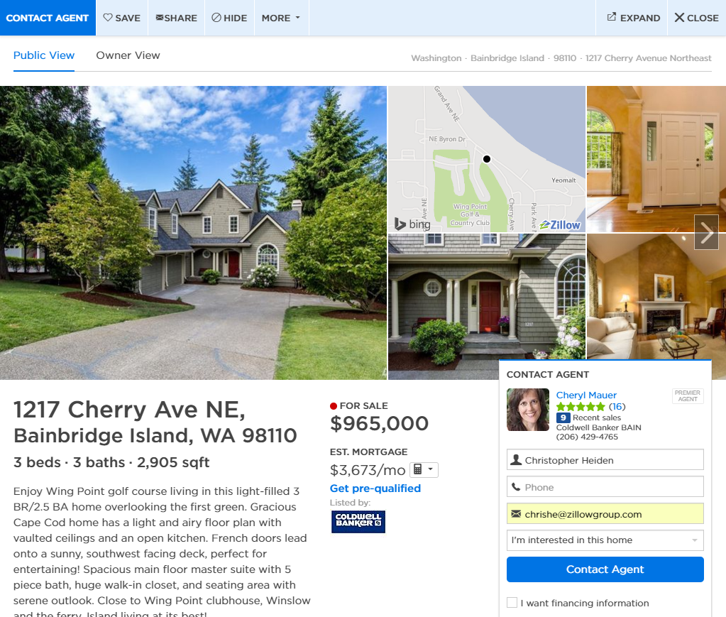
Let’s talk about this handshake
Notes:
Buyers especially come to Zillow to shop for homes.
Agents know this, and they want to be connected with those buyers.
Some agents use Zillow as THE way they get new customers.

Slide 12


Lots of buyers
Fewer Zillow real estate agents
Notes:
We want to connect as many buyers/sellers with agents as possible
-Good for beth
-Goof for alan
-Good for ZG
ALIGNED INCENTIVES!
“Zillow needs more Premier Agents so that this doesn’t happen”

Slide 13
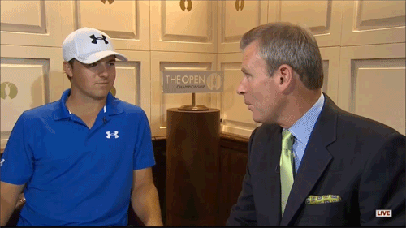
Zillow needs more Premier Agents so this doesn’t happen

Slide 14

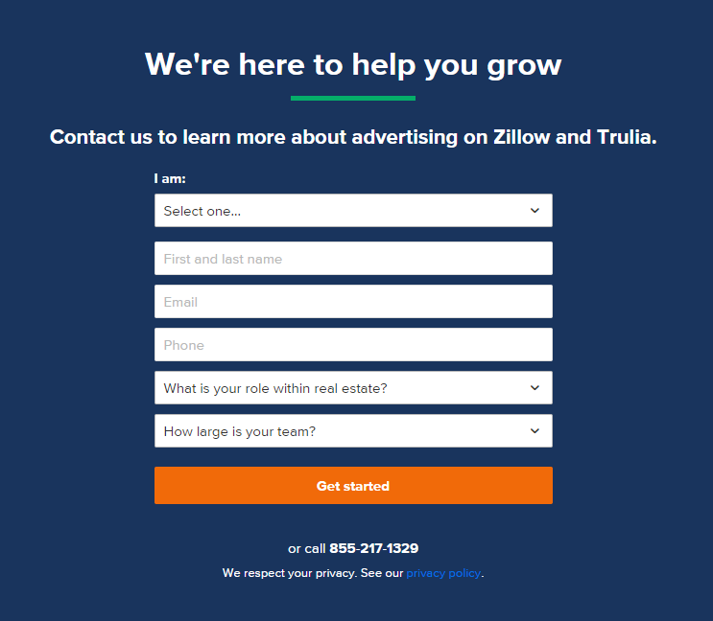

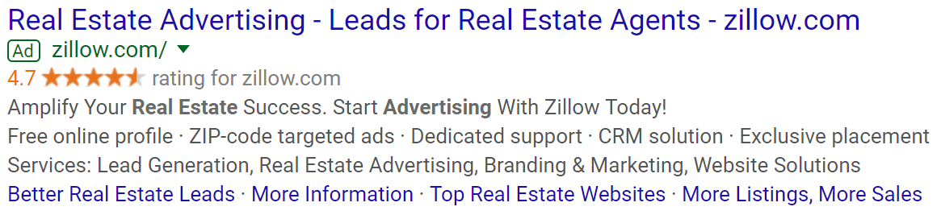




Simple acquisition flow
(Joy)
Notes:
Focus on monthly spend

Slide 15






Multiple starting points…

Slide 16
…and agents may interact with Zillow via multiple channels
Notes:
It’s really hard for ZG Analytics to know how beneficial google or facebook or email are (in terms of acquiring agents) because agents interact with multiple acquisition channels/triggers all the time.
But before we get to the problem we need you to solve….

Slide 17
Let’s talk about data
First…things that may contribute to an agent purchasing advertising on Zillow.com

Slide 18
RE Agent Leads
REAgentID | SalesRepID | LeadPlatform | LeadType | LeadVendor | LeadDateTime
0033300001giP3WAAU | 00533000002mYFzAAM | Web | Paid | Google Search | 1/10/2017 11:30
0033300001fLKowAAG | 00533000002mYGaAAM | Web | Organic |  | 1/10/2017 11:31
0034000001beSUyAAM | 005330000045SGNAA2 | Web | Email | Email | 1/10/2017 11:31
0033300001rSTerAAG | 00540000002lAXpAAM | Web | Paid | Google Search | 1/10/2017 11:32
0033300001fM90xAAC | 00533000003grFeAAI | Phone | Paid | Google Search | 10/13/2016 11:00
0033300001fLC2GAAW | 00533000003hosQAAQ | Web | Email | Email | 1/10/2017 11:35
0034000000pd2xnAAA | 00533000002mqr5AAA | Web | Email | Email | 1/10/2017 11:36
272K rows
Notes:
When you get this file, explore what’s in the platform/type/vendor columns

Slide 19
RE Agent – Sales Rep Phone Calls
REAgentID | SalesRepID | PhoneCallType | PhoneCallDateTime | TalkTimeMinutes
0034000001JwfjRAAR | 00533000002mY8rAAE | Sales Rep Called RE Agent | 10/5/2016 10:46 | 0.1
 | 005400000024jMGAAY | RE Agent Called Sales Rep | 10/5/2016 10:46 | 0
0033300001pVBqhAAG | 00533000003gzn0AAA | Sales Rep Called RE Agent | 10/5/2016 10:46 | 0.2
 | 00533000003gXQrAAM | Sales Rep Called RE Agent | 10/5/2016 10:46 | 0.1
 | 00533000003StEEAA0 | RE Agent Called Sales Rep | 10/5/2016 10:46 | 1.4
0034000001GHBQJAA5 | 00533000002miChAAI | Sales Rep Called RE Agent | 10/5/2016 10:46 | 1.1
0033300001el63PAAQ | 00540000002iqyFAAQ | RE Agent Called Sales Rep | 10/5/2016 10:46 | 8.5
8.7MM rows, 2 files
Notes:
Note the…
missing data
and some short talk times

Slide 20
RE Agent – Sales Rep Meetings
REAgentID | SalesRepID | SalesMeetingDate
0034000000uWTKPAA4 | 00533000002mOerAAE | 6/30/2017
0034000000zAS2SAAW | 00533000003mRApAAM | 6/30/2017
00340000019JWGoAAO | 00533000002mOerAAE | 6/30/2017
0034000000avJilAAE | 00533000002mY90AAE | 6/30/2017
0033300001pXozTAAS | 00533000003hogtAAA | 6/30/2017
0034000000pAvyqAAC | 0054000000254LvAAI | 6/30/2017
0034000001BTDmgAAH | 005400000024znbAAA | 6/30/2017
1,003 rows
Notes:
OK there are other things that might get an agent to sign up for ZG advertising
-Organic facebook impressions
-TV advertising
-Referrals
You can ignore those.

Slide 21
Let’s talk about more data
The stuff other than marketing/sales interactions

Slide 22
RE Agent Acquisition (date of first ever purchase of ads on Z.com)
ZUID | AcquisitionDate
1219858 | 2017-06-21
8683121 | 2017-06-26
10507903 | 2017-01-28
24388286 | 2017-03-10
5837712 | 2017-01-01
54477231 | 2016-06-28
9779068 | 2016-05-30
161K rows

Slide 23
REAgentID / ZUID Lookup
REAgentID | ZUID
0033300001rTYgeAAG | 37263746
0034000001dIajEAAS | 35226891
0033300001ejZNrAAM | 22163901
0034000001BSq2UAAT | 2003350
0034000001JwWgiAAF | 13322361
0034000001Aunt1AAB | 2004846
0034000000uVsZuAAK | 6141907
518K rows

Slide 24
Marketing / Sales Factors
Lead Channel | Cost per lead
Paid Social | $150
Paid Search – Bing | $80
Paid Search – Google | $100
Email | $10
Organic | Free
Sales Activity | Cost per Activity
Outbound Phone Calls | $10
Inbound Phone Calls | $10
Meetings | $300
Lead Type | Conversion Rate | Typical 2-year NPV of an acquired agent
Paid | 5.5% | $7.0K
Email | 7.0% | $8.0K
Organic | 6.5% | $7.5K
Notes:
That NPV number…we currently do last touch attribution (and that’s how I’m associating it).

Slide 25
Analysis Problems
Given an individual agent ‘speaks’ to Zillow through a variety of marketing and sales channels before purchasing advertising, how much ‘credit’ should be assigned to each type of interaction (inclusive of marketing and sales)? What’s the associated ROI of spend on marketing & sales?
How should Zillow apply these findings? Do you have any suggestions for how Zillow may change the allocation of their advertising dollars or sales floor involvement?
With more time and resources, how would you make this smarketing analysis better?
Notes:
This is pretty open-ended, so be creative!

Slide 26
Rubric & Guidelines
You will be graded on the following:
Data Preparation (15%)
Assumptions (15%)
Solution (30%)
Technique / Applicability
Creative Thinking
Presentation (30%)
Data Visualization / Story
Verbal skills
ZG Discretionary (10%)
Dos and Don’ts
Do be thoughtful about which fields / columns / tables to use and which to exclude.
Do consider how to handle messy / missing data points.
Do ask questions of your ZG Analytics advisors.
Do find a way to recognize team members’ contributions.
Do consider your audience (the board).
Don’t force everyone to have a speaking role.
Don’t assume we’ve made this easy for you to solve.
Notes:
ZG analytics will do the grading.

